Slide 1
Ooma Home Security Automation
Disen Chitilapilly Devassy

Slide 2
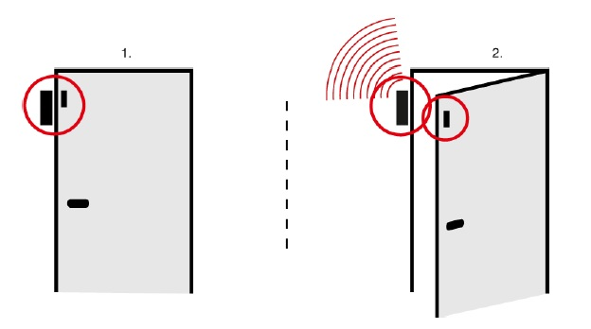

Home Security Automation Architecture
Ooma Client
Mobile App
HMS Server
Test Framework
Beagle Bone

Slide 3
Bring up Call Flow
Auto FW
HM Server
Client Telo
Beagle Bone
Sensors – 1,2,3
Check the Server status
Server status – Good/Bad
Check the Client Status – Online/HMS Enabled/Running
Client Status Good/Bad
Ssh to Beagle bone/ Access GPIOS of sensors?
Access GPIOs of Sensor 1
Yes/No
Access GPIOs of Sensor 1
Yes/No
Pass/Fail

Slide 4
Framework
Python Based Automation
Flask API’s for REST Communication
Beagle bone for emulating Sensors

Slide 5
Why Flask Based Automation
micro-frameworks
Easy Learning
Fast
Really no need to follow mvc or mtv.
Django needs deep learning curve.

Slide 6
REST APIs
Sensor Status
http://hms-proxy-qa.ooma.com:8083/hms/api/devices/256/status?username=kb8whtmr99q48uutjd5k75ws7gif4v7j
{
"state": 0,
"batteryStatus": 0,
"connectionStatus": 1,
"tamperStatus": 1
}
All Modes
http://hms-proxy-qa.ooma.com:8083/hms/api/modes?username=wigt2rx4db9dbcu9f4n5hnnf5x7evm58
[{"id":219,"name":"Home","runSettings":{"current":false,"paused":false,"modeSchedules":[{"id":240,"startTime":"18:00","days":127}]}},{"id":220,"name":"Away","runSettings":{"current":true,"paused":false,"modeSchedules":[{"id":241,"startTime":"08:00","days":127}]}},{"id":221,"name":"Night","runSettings":{"current":false,"paused":false,"modeSchedules":[{"id":242,"startTime":"21:00","days":127}]}},{"id":283,"name":"new","runSettings":{"current":false,"paused":false,"modeSchedules":[]}},{"id":284,"name":"new Mode","runSettings":{"current":false,"paused":false,"modeSchedules":[]}},{"id":285,"name":"Mode1","runSettings":{"current":false,"paused":false,"modeSchedules":[]}}]

Slide 7
Search based on sensor id
http://hms-proxy-qa.ooma.com:8083/hms/api/devices/678?username=wigt2rx4db9dbcu9f4n5hnnf5x7evm58
{"id":678,"name":"Water Sensor 1 vco","beehiveName":"02e9e00117","type":"WATER_LEAKAGE","model":"dectFloodDetector","alert":true,"state":0,"status":{"state":-1,"batteryStatus":-1,"connectionStatus":-1}}
Check different modes
http://hms-proxy-qa.ooma.com:8083/hms/api/modes/283?username=wigt2rx4db9dbcu9f4n5hnnf5x7evm58
{"id":283,"name":"new","runSettings":{"current":false,"paused":false,"modeSchedules":[]}}
Notification Settings in Home Mode
http://hms-proxy-qa.ooma.com:8083/hms/api/devices/678/notification_settings/219?username=wigt2rx4db9dbcu9f4n5hnnf5x7evm58
{"push":"on","telo":"on","phone":"off","email":"on","sms":"on","conditionRaised":1,"conditionCeased":1}
SMS Phone No
http://hms-proxy-qa.ooma.com:8083/hms/api/base/notification/sms?username=wigt2rx4db9dbcu9f4n5hnnf5x7evm58
["8583973190@tmomail.net","987654321","6504338086@txt.att.net”]
Email ID
http://hms-proxy-qa.ooma.com:8083/hms/api/base/notification/email?username=wigt2rx4db9dbcu9f4n5hnnf5x7evm58
["disen@ooma.com”]

Slide 8
Sensor Simulation
DEVICE 1: 02e9e00117
UNIT 0: type='System'
14697f05: D1U0S1I342458117 - server 'UnknownInterface'
00000115: D1U0S1I277 - server 'ActiveDevice'
00000110: D1U0S1I272 - server 'BatteryIndicator'
00000101: D1U0S1I257 - server 'TamperDetector'
14697eef: D1U0S1I342458095 - server 'IdentifyInputDevice'
00000004: D1U0S1I4 - server 'IdentifyDevice'
14697eee: D1U0S1I342458094 - server 'UnregisterDevice'
14697eed: D1U0S1I342458093 - server 'Announcement'
00000005: D1U0S1I5 - server 'UnknownInterface'
UNIT 1: type='Flood Detector'
00000100: D1U1S1I256 - server 'Alert’
Using the above interfaces, we can trigger various events in Sensors.

Slide 9
Test case – Trigger Pairing Mode
Auto FW
HM Server
Client Telo
Beagle Bone
Sensors – 1,2,3
Trigger – Pairing Mode
Result – success/Fail
Trigger GPIO for pairing
Access Pairing GPIOs of Sensor 1
Result – success/Fail
Result – success/Fail

Slide 10
Test case – Trigger Tampering
Auto FW
HM Server
Client Telo
Beagle Bone
Sensors – 1,2,3
Trigger GPIO for Tampering
Access Tampering GPIOs of Sensor 1
Result – success/Fail
Result – success/Fail
Verifying the tampering Mode
Result – success/Fail

Slide 11
Thank You

